Slide 1
Supply, Demand,
and Government Policies
CHAPTER
6

Slide 2
Look for the answers to these questions:
What are price ceilings and price floors?
What are some examples of each?
How do price ceilings and price floors affect market outcomes?
How do taxes affect market outcomes?
How do the effects depend on whether
the tax is imposed on buyers or sellers?
What is the incidence of a tax?
What determines the incidence?
Notes:
When we talk about how a policy “affects the market outcome,” we mean the policy’s impact on the price and quantity of the good and therefore on the market’s allocation of resources.

Slide 3
Government Policies That Alter the
Private Market Outcome
Price controls
  Price ceiling: legal maximum on the price at which a good can be sold
    Rent-control laws
  Price floor: legal minimum on the price at which a good can be sold
    Minimum wage laws
Taxes: government can make buyers or sellers pay a specific amount on each unit
Notes:
This slide outlines the chapter.
We will use the supply/demand model to see how each policy affects the market outcome (the price buyers pay, the price sellers receive, and eq’m quantity).

Slide 4
EXAMPLE 1: The Market for Apartments
P
S
Rental price of apartments
Equilibrium without price controls
$800
D
Q
300
Quantity
of apartments

Slide 5
How Price Ceilings Affect Market Outcomes
P
S
A price ceiling above the equilibrium price is not binding—
has no effect on the market outcome.
Price
ceiling
$1000
$800
D
Q
300

Slide 6
How Price Ceilings Affect Market Outcomes
The equilibrium price ($800) is above the ceiling and therefore illegal.
The price ceiling is binding, causes a shortage.
P
S
$800
Price
ceiling
$500
shortage
D
Q
250
400

Slide 7
How Price Ceilings Affect Market Outcomes
In the long run, supply and demand of rental apartments are more price-elastic.
So, the shortage
is larger.
P
S
$800
Price
ceiling
$500
shortage
D
Q
150
450
Notes:
In this slide, the equilibrium price ($800) and price ceiling ($500) are the same as on the preceding slides, but supply and demand are more price-elastic than before, and the shortage that results from a binding price ceiling is larger.
The adverse effects of rent control in the long run: large shortage of housing
Landlords: are not building new apartments and are failing to maintain existing ones
People: more people want to find their own apartments and more people to move into a city
Inefficient rationing mechanisms: long waiting lists; preference to tenants without children; discriminate on the basis of race; bribes to building superintendents

Slide 8
Shortages and Rationing
Because of shortage
  Sellers must ration the goods among buyers
Some rationing mechanisms:
    Long lines
    Discrimination according to sellers’ biases
  Are often unfair and inefficient
    The goods do not necessarily go to the buyers who value them most highly
Notes:
In contrast, when prices are not controlled, the rationing mechanism is efficient (the goods go to the buyers that value them most highly) and impersonal (and thus fair).

Slide 9
EXAMPLE 2: The Market for Unskilled Labor
W
S
Wage paid to unskilled workers
Equilibrium without price controls
$6.00
D
L
500
Quantity of unskilled workers

Slide 10
How Price Floors Affect Market Outcomes
W
S
A price floor below the equilibrium price is not binding – has no effect on the market outcome.
$6.00
Price
floor
$5.00
D
L
500
Notes:
Some students may wonder why the $5 price floor does not cause a shortage. After all, at a wage of $5, the quantity of unskilled workers that firms wish to hire exceeds the quantity of unskilled workers that are looking for jobs.
But the minimum wage law does not stop the wage from rising above $5. So, in response to this shortage, the wage will rise until the shortage disappears – which occurs at the equilibrium wage of $6. The equilibrium wage is perfectly legal when the price floor (i.e. minimum wage) is below it.

Slide 11
How Price Floors Affect Market Outcomes
The equilibrium wage ($6) is below the floor and therefore illegal.
The price floor is binding, causes a surplus (i.e., unemployment).
Minimum wage laws do not affect highly skilled workers. They do affect teen workers. A 10% increase in the minimum wage raises teen unemployment by 1–3%.
labor surplus
W
S
Price
floor
$7.25
$6.00
D
L
400
550

Slide 12
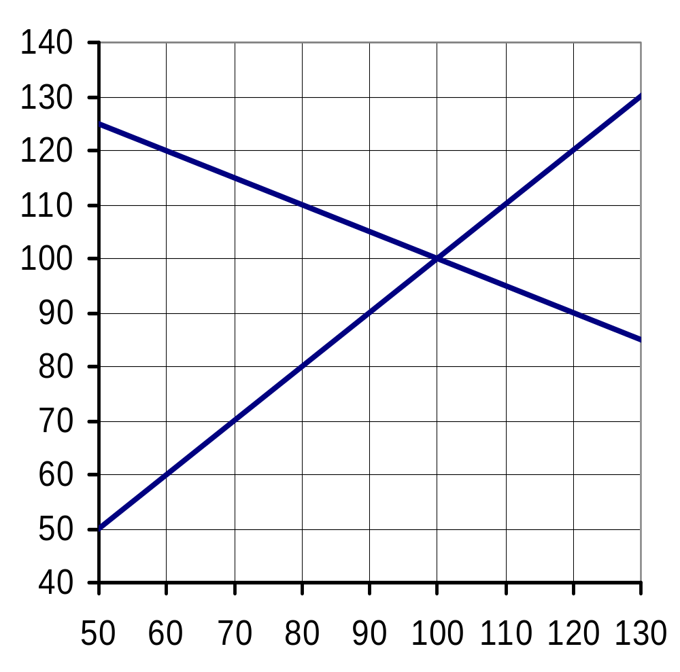
Active Learning 1 Price controls
The market for hotel rooms is in equilibrium as in the graph.
Determine the effects of:
  $90 price ceiling
  $90 price floor
  $120 price floor
The market for
hotel rooms
P
S
D
0
Q
Notes:
A good exercise to break up the lecture, engage students, and assess their learning so far.

Slide 13
Active Learning 1 A. $90 price ceiling
The market for
hotel rooms
P
The price falls to $90. (binding price ceiling below the equilibrium)
Buyers demand
120 rooms, sellers supply 90, leaving a shortage.
S
Price ceiling
D
shortage = 30
0
Q

Slide 14
Active Learning 1 B. $90 price floor
The market for
hotel rooms
P
Equilibrium price is above the $90 price floor, so the price floor is not binding.
P = $100,
Q = 100 rooms.
S
Price floor
D
0
Q

Slide 15
Active Learning 1 C. $120 price floor
The market for
hotel rooms
P
The price rises to $120. (binding price floor above the equilibrium)
Buyers demand
60 rooms, sellers supply 120, causing a surplus.
S
surplus = 60
Price floor
D
0
Q

Slide 16
Evaluating Price Controls
Markets are usually a good way to organize economic activity
  Economists usually oppose price ceilings and price floors
  Prices are not the outcome of some haphazard process
  Prices have the crucial job of balancing supply and demand
    Coordinating economic activity

Slide 17
Evaluating Price Controls
Governments can sometimes improve market outcomes
  Want to use price controls
    Because of unfair market outcome
    Aimed at helping the poor
  Often hurt those they are trying to help
  Other ways of helping those in need
    Rent subsidies
    Wage subsidies (earned income tax credit)
Notes:
It might be worth reminding students that our analysis has been in the context of a world without market failures. Subsequent chapters (except in the macro split) will introduce situations in which government intervention can improve on the private market outcome. However, even in such cases, the appropriate policy is usually something other than a direct price control.

Slide 18
Taxes
Government uses taxes
  To raise revenue for public projects
    Roads, schools, and national defense
Tax incidence
  Manner in which the burden of a tax is shared among participants in a market
    The government can make the seller or the buyer to pay the tax
Notes:
The tax can be a percentage of the good’s price, or a specific amount for each unit sold. For simplicity, we analyze per-unit taxes only.

Slide 19
EXAMPLE 3: The Market for Pizza
P
S₁
Equilibrium without tax
$10.00
D₁
Q
500

Slide 20
A Tax on Buyers
Effects of a $1.50 per unit tax on buyers
Hence, a tax on buyers shifts the D curve down by the amount of the tax.
The price buyers pay is now $1.50 higher than the market price P.
P would have to fall by $1.50 to make buyers willing to buy same Q as before.
E.g., if P falls from $10.00 to $8.50, buyers are still willing to purchase 500 pizzas.
P
S₁
$10.00
Tax
$8.50
D₁
D₂
Q
500

Slide 21
A Tax on Buyers
Effects of a $1.50 per unit tax on buyers
New equilibrium:
Q = 450
Sellers receive P_{S} = $9.50
Buyers pay P_{B} = $11.00
Difference between them = $1.50 = tax
P
S₁
P_{B} =
$11.00
Tax
$10.00
P_{S} =
$9.50
D₁
D₂
Q
450
500
Notes:
How taxes on buyers affect market outcomes:
Buyers and sellers share the burden of tax
Sellers get a lower price, are worse off
Buyers pay a lower market price, are worse off: Effective price (with tax) rises

Slide 22
The Incidence of a Tax:
how the burden of a tax is shared among
market participants
P
In our example,
buyers pay
$1.00 more,
sellers get
$0.50 less.
S₁
P_{B} =
$11.00
Tax
$10.00
P_{S} =
$9.50
D₁
D₂
Q
450
500
Notes:
22
“Market participants” simply means buyers and sellers.

Slide 23
A Tax on Sellers
Effects of a $1.50 per unit tax on sellers
The tax effectively raises sellers’ costs by $1.50 per pizza.
Sellers will supply 500 pizzas only if P rises to $11.50, to compensate for this cost increase.
Hence, a tax on sellers shifts the S curve up by the amount of the tax.
P
S₂
$11.50
Tax
S₁
$10.00
D₁
Q
500
Notes:
The government makes sellers pay a $1.50 on each pizza they sell. The new, red supply curve reflects sellers’ supply as a function of the after-tax price.

Slide 24
A Tax on Sellers
Effects of a $1.50 per unit tax on sellers
New equilibrium:
Q = 450
Buyers pay P_{B} = $11.00
Sellers receive P_{S} = $9.50
Difference between them = $1.50 = tax
P
S₂
S₁
P_{B} =
$11.00
Tax
$10.00
P_{S} =
$9.50
D₁
Q
450
500

Slide 25
The Outcome Is the Same in Both Cases!
The effects on P and Q, and the tax incidence are the same whether the tax is imposed on buyers or sellers!
P
S₁
P_{B} =
$11.00
Tax
$10.00
A tax drives
a wedge between the price buyers pay and the price sellers receive.
P_{S} =
$9.50
D₁
450
500
Q

Slide 26
Active Learning 2 Effects of a tax
The market for
hotel rooms
The market for hotel rooms is in equilibrium as in the graph.
Suppose the government imposes a tax on buyers of $30 per room
Find the new
Q, P_{B}, P_{S}, and incidence of tax.
P
S
D
0
Q
Notes:
These are the same supply and demand curves used in the previous exercise.

Slide 27
Active Learning 2 Answers
The market for
hotel rooms
P
Q = 80
P_{B} = $110
P_{S} = $80
Incidence
  buyers: $10
  sellers: $20
S
P_{B} =
Tax
P_{S} =
D
0
Q

Slide 28
Elasticity and Tax Incidence
CASE 1: Supply is more elastic than demand
P
It’s easier for sellers than buyers to leave the market.
So buyers bear most of the burden of the tax.
P_{B}
S
Buyers’ share of tax burden
Tax
Price if no tax
Sellers’ share of tax burden
P_{S}
D
Q
Notes:
28

Slide 29
Elasticity and Tax Incidence
CASE 2: Demand is more elastic than supply
It’s easier for buyers than sellers to leave the market.
Sellers bear most of the burden of the tax.
P
S
Buyers’ share of tax burden
P_{B}
Price if no tax
Tax
Sellers’ share of tax burden
P_{S}
D
Q
Notes:
29

Slide 30
Summary
A price ceiling is a legal maximum on the price of a good. An example is rent control. If the price ceiling is below the equilibrium price, it is binding and causes a shortage.
A price floor is a legal minimum on the price of a good. An example is the minimum wage. If the price floor is above the equilibrium price, it is binding and causes a surplus. The labor surplus caused by the minimum wage is unemployment.

Slide 31
Summary
A tax on a good places a wedge between the price buyers pay and the price sellers receive, and causes the equilibrium quantity to fall, whether the tax is imposed on buyers or sellers.
The incidence of a tax is the division of the burden of the tax between buyers and sellers, and does not depend on whether the tax is imposed on buyers or sellers.
The incidence of the tax depends on the price elasticities of supply and demand.

