Slide 1
CHAPTER
13
The Costs
of Production

Slide 2

Active Learning 1 Brainstorming costs
You run Ford Motor Company.
List three different costs you have.
List three different
business decisions
that are affected
by your costs

Slide 3
Look for the answers to these questions:
What is a production function? What is marginal product? How are they related?
What are the various costs? How are they related to each other and to output?
How are costs different in the short run vs.
the long run?
What are “economies of scale”?

Slide 4
Total Revenue, Total Cost, Profit
We assume that the firm’s goal is to maximize profit.
Profit = Total revenue – Total cost
the amount a firm receives from the sale of its output
TR = P×Q
the market value of the inputs a firm uses in production

Slide 5
Costs: Explicit vs. Implicit
‘The cost of something is what you give up to get it.’
Explicit costs
  Require an outlay of money
    E.g., paying wages to workers.
Implicit costs
  Do not require a cash outlay
    E.g., the opportunity cost of the owner’s time.
Total cost = Explicit + Implicit costs
Notes:
The first bullet point is one of the 10 principles.
This is true whether the costs are implicit or explicit. Both matter for firms’ decisions

Slide 6
Explicit vs. Implicit Costs: An Example
You need $100,000 to start your business. The interest rate is 5%.
Case 1: borrow $100,000
  explicit cost = $5000 interest on loan
Case 2: use $40,000 of your savings,
borrow the other $60,000
  explicit cost = $3000 (5%) interest on the loan
  implicit cost = $2000 (5%) foregone interest you could have earned on your $40,000.
In both cases, total (exp + imp) costs are $5000
Notes:
In Case 2, the foregone interest is the interest you could have earned on your savings. It is an opportunity cost.
This example shows that an important implicit cost is the cost of capital, the foregone returns you could have earned had you used your savings to buy bonds or other assets instead of investing them in your business.
The hope is that students will see that what really matters to them is not just the explicit costs, but total (implicit + explicit) costs.

Slide 7
Economic Profit vs. Accounting Profit
Accounting profit
  =total revenue minus total explicit costs
Economic profit
  =total revenue minus total costs (including explicit and implicit costs)
Accounting profit ignores implicit costs,
so it’s higher than economic profit.
Notes:
Accountants keep track of how much money flows into and out of the firm, so they ignore implicit costs.
Economists study the pricing and production decisions of firm, which are affected by implicit as well as explicit costs.

Slide 8
Active Learning 2
Economic profit vs. accounting profit
The equilibrium rent on office space has just increased by $500/month.
Determine the effects on accounting profit and economic profit if:
  a. you rent your office space
  b. you own your office space

Slide 9
Active Learning 2 Answers
The rent on office space increases $500/month.
a. You rent your office space.
Explicit costs increase $500/month. Accounting profit & economic profit each fall $500/month.
b. You own your office space.
Explicit costs do not change, so accounting profit does not change.
Implicit costs increase $500/month (opp. cost
of using your space instead of renting it) so economic profit falls by $500/month.

Slide 10
Production Function
Production function
  Relationship between
    Quantity of inputs used to make a good
    And the quantity of output of that good
  Gets flatter as production rises

Slide 11
EXAMPLE 1: Farmer Jack
Example 1:
Farmer Jack grows wheat.
He has 5 acres of land (fixed resource).
He can hire as many workers as he wants.
  The quantity of output produced varies with the number of workers hired
Notes:
In the following slides, Example 1 will be used to illustrate the production function, marginal product, and a first look at the costs of production.

Slide 12
EXAMPLE 1: Farmer Jack’s Production Function
0
L
(no. of workers)
Q (bushels
of wheat)
3,000
2,500
0
0
2,000
1
1000
1,500
Quantity of output
2
1800
1,000
3
2400
500
4
2800
0
5
3000
0
1
2
3
4
5
No. of workers
Notes:
12

Slide 13
Marginal Product
Marginal product
  Increase in output that arises from an additional unit of input
    Other inputs constant
  Slope of the production function
Marginal product of labor, MPL
  MPL = ∆Q/∆L
  If Jack hires one more worker, his output rises by the marginal product of labor.
Notes:
Notation:
∆ (delta) = “change in…”
∆Q = change in output,
∆L = change in labor

Slide 14
EXAMPLE 1: Total & Marginal Product
0
L
(no. of workers)
Q (bushels
of wheat)
MPL
0
0
∆L = 1
∆Q = 1000
1000
1
1000
∆L = 1
∆Q = 800
800
2
1800
∆L = 1
∆Q = 600
600
3
2400
∆L = 1
∆Q = 400
400
4
2800
∆L = 1
∆Q = 200
200
5
3000
Notes:
14

Slide 15
Diminishing MPL
Diminishing marginal product
  Marginal product of an input declines as the quantity of the input increases
  Production function gets flatter as more inputs are being used:
    The slope of the production function decreases

Slide 16
EXAMPLE 1: MPL = Slope of Prod Function
0
L
(no. of workers)
Q
(bushels
of wheat)
MPL
MPL equals the
slope of the production function.
Notice that
MPL diminishes
as L increases.
This explains why the production function gets flatter
as L increases.
3,000
2,500
0
0
1000
2,000
1
1000
Quantity of output
800
1,500
2
1800
600
1,000
3
2400
500
400
4
2800
200
0
5
3000
0
1
2
3
4
5
No. of workers
Notes:
16
MPL equals the slope of the production function.
Notice that MPL diminishes as L increases.
This explains why the production function gets flatter as L increases.

Slide 17
Why MPL Is Important
‘Rational people think at the margin’
When Farmer Jack hires an extra worker
  His costs rise by the wage he pays the worker
  His output rises by MPL
  Comparing them helps Jack decide whether he should hire the worker.
Notes:
Thinking at the margin helps not only Jack, but all managers in the real world, who make business decisions every day by comparing marginal costs with marginal benefits.

Slide 18
Why MPL Diminishes
Farmer Jack’s output rises by a smaller and smaller amount for each additional worker. Why?
  As Jack adds workers, the average worker has less land to work with and will be less productive.
  In general, MPL diminishes as L rises
  whether the fixed input is land or capital (equipment, machines, etc.).

Slide 19
EXAMPLE 1: Farmer Jack’s Costs
Farmer Jack must pay $1000 per month for the land, regardless of how much wheat he grows.
The market wage for a farm worker is $2000 per month.
So Farmer Jack’s costs are related to how much wheat he produces….

Slide 20
EXAMPLE 1: Farmer Jack’s Costs
0
L
(no. of workers)
Q
(bushels
of wheat)
Cost of land
Cost of labor
Total
cost
0
0
$1,000
$0
$1,000
1
1000
$1,000
$2,000
$3,000
2
1800
$1,000
$4,000
$5,000
3
2400
$1,000
$6,000
$7,000
4
2800
$1,000
$8,000
$9,000
5
3000
$1,000
$10,000
$11,000
Notes:
20

Slide 21
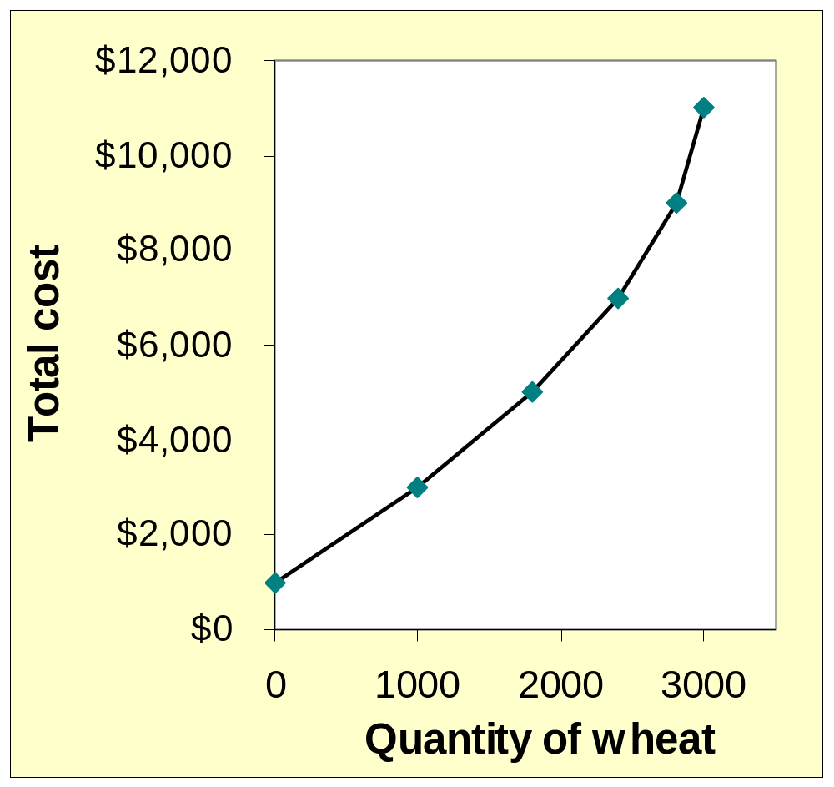
EXAMPLE 1: Farmer Jack’s Total Cost Curve
Q (bushels of wheat) | Total Cost
0 | $1,000
1000 | $3,000
1800 | $5,000
2400 | $7,000
2800 | $9,000
3000 | $11,000
Notes:
21
Total-cost curve: relationship between quantity produced and total costs; Gets steeper as the amount produced rises b/c of diminishing marginal product: producing one additional unit of output requires a lot of additional units of inputs.

Slide 22
Marginal Cost
Marginal cost, MC
  Increase in total cost arising from an extra unit of production
  Marginal cost = Change in total cost / Change in quantity
  MC = ΔTC / ΔQ
  Increase in total cost
    From producing an additional unit of output

Slide 23
EXAMPLE 1: Total and Marginal Cost
Q
(bushels
of wheat)
Total
Cost
Marginal Cost (MC)
0
$1,000
∆Q = 1000
∆TC = $2000
$2.00
1000
$3,000
∆Q = 800
∆TC = $2000
$2.50
1800
$5,000
∆Q = 600
∆TC = $2000
$3.33
2400
$7,000
∆Q = 400
∆TC = $2000
$5.00
2800
$9,000
∆Q = 200
∆TC = $2000
$10.00
3000
$11,000
Notes:
23

Slide 24
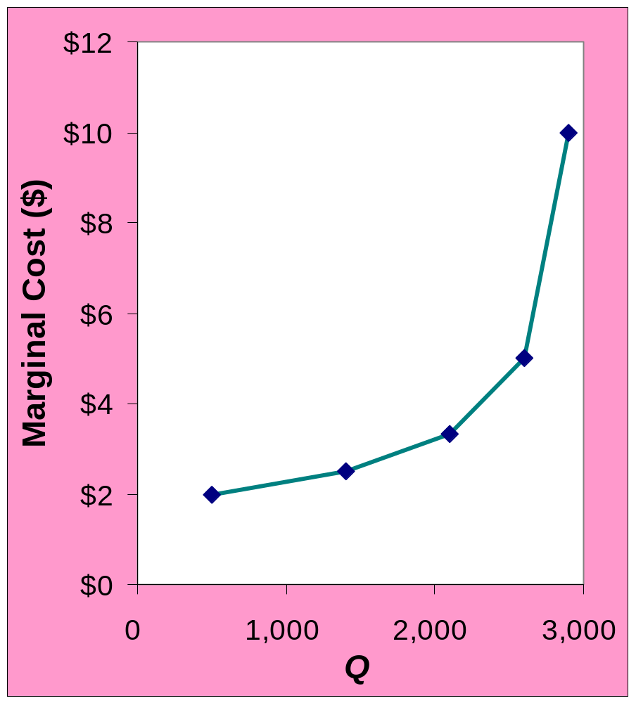
EXAMPLE 1: The Marginal Cost Curve
Q
(bushels
of wheat)
TC
MC
MC usually rises
as Q rises,
as in this example.
0
$1,000
$2.00
1000
$3,000
$2.50
1800
$5,000
$3.33
2400
$7,000
$5.00
2800
$9,000
$10.00
3000
$11,000
Notes:
24
MC usually rises as Q rises, as in this example.

Slide 25
Why MC Is Important
Farmer Jack is rational and wants to maximize his profit
  To increase profit, should he produce more or less wheat?
    Farmer Jack needs to “think at the margin”
  If the cost of additional wheat (MC) is less than the revenue he would get from selling it, then Jack’s profits rise if he produces more.
Notes:
In the next chapter, we will learn more about how firms choose Q to maximize their profits.

Slide 26
Fixed and Variable Costs
Fixed costs, FC, do not vary with the quantity of output produced
    For Farmer Jack, FC = $1000 for his land
    Other examples: cost of equipment, loan payments, rent
Variable costs, VC, vary with the quantity of output produced
    For Farmer Jack, VC = wages he pays workers
    Other example: cost of materials
Total cost = Fixed cost + Variable cost
Notes:
If you did Active Learning 1 and created a class-generated list of Ford Motor Company’ costs, you might return to that list and ask students which of the costs on their list are fixed and which are variable.

Slide 27
EXAMPLE 2: Production Costs
Our second example is more general,
applies to any type of firm producing any good with any types of inputs.
  Calculate and graph TC knowing FC and VC
  Calculate and graph marginal and average costs
  Understand the relationship between marginal cost and average cost

Slide 28
EXAMPLE 2: Costs: TC = FC + VC
0
$800
FC
Q
FC
VC
TC
VC
$700
0
$100
$0
$100
TC
$600
1
100
70
170
$500
2
100
120
220
Costs
$400
3
100
160
260
$300
4
100
210
310
$200
5
100
280
380
$100
6
100
380
480
7
100
520
620
$0
0
1
2
3
4
5
6
7
Q
Notes:
28

Slide 29
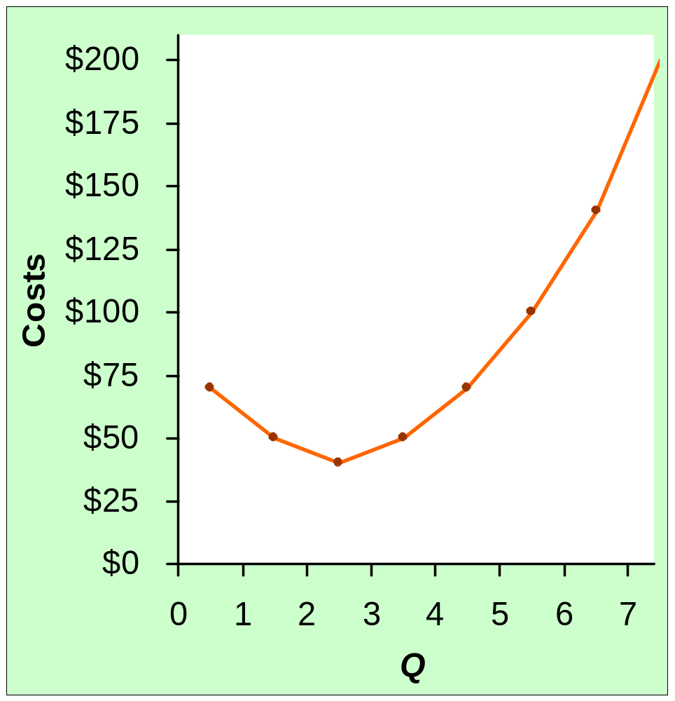
EXAMPLE 2: Marginal Cost
Recall, Marginal Cost (MC)
is the change in total cost from producing one more unit:
Usually, MC rises as Q rises, due to diminishing marginal product.
Sometimes (as here), MC falls before rising.
(In other examples, MC may be constant.)
Q
TC
MC
0
$100
$70
∆TC
MC =
1
170
∆Q
50
2
220
40
3
260
50
4
310
70
5
380
100
6
480
140
7
620
Notes:
29

Slide 30
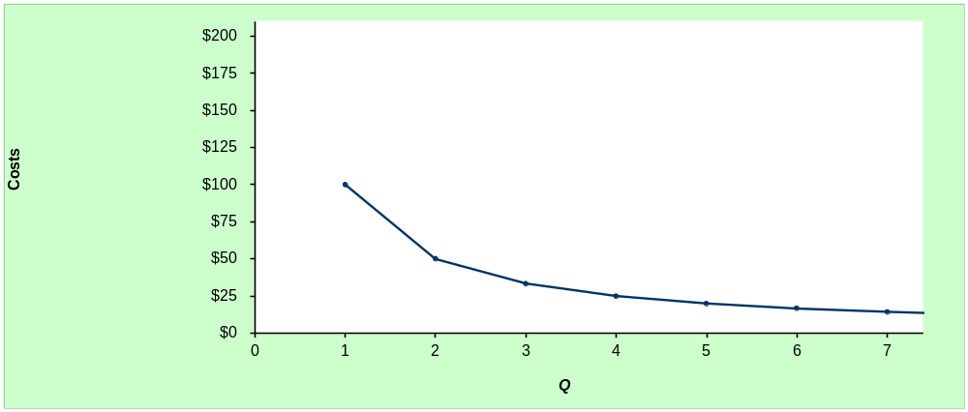
EXAMPLE 2: Average Fixed Cost, AFC
0
Average fixed cost (AFC)
is fixed cost divided by the quantity of output:
AFC = FC/Q
Notice that AFC falls as Q rises: The firm is spreading its fixed costs over a larger and larger number of units.
Q
FC
AFC
0
$100
n/a
1
100
$100
2
100
50
3
100
33.33
4
100
25
5
100
20
6
100
16.67
7
100
14.29
Notes:
30

Slide 31
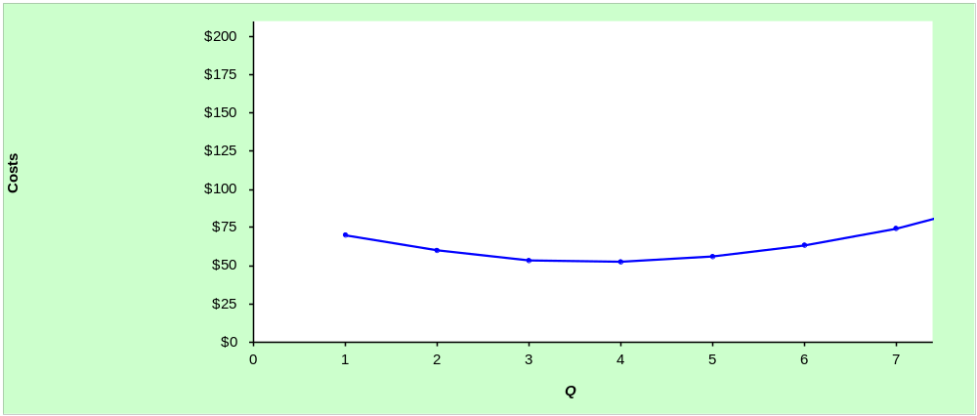
EXAMPLE 2: Average Variable Cost, AVC
0
Average variable cost (AVC)
is variable cost divided by the quantity of output:
AVC = VC/Q
As Q rises, AVC may fall initially. In most cases, AVC will eventually rise as output rises.
Q
VC
AVC
0
$0
n/a
1
70
$70
2
120
60
3
160
53.33
4
210
52.50
5
280
56.00
6
380
63.33
7
520
74.29
Notes:
31

Slide 32
EXAMPLE 2: Average Total Cost
0
Average total cost (ATC) equals total cost divided by the quantity of output:
ATC = TC/Q
Also,
ATC = AFC + AVC
Q
TC
ATC
AFC
AVC
0
$100
n/a
n/a
n/a
1
170
$170
$100
$70
2
220
110
50
60
3
260
86.67
33.33
53.33
4
310
77.50
25
52.50
5
380
76
20
56.00
6
480
80
16.67
63.33
7
620
88.57
14.29
74.29
Notes:
32

Slide 33
EXAMPLE 2: Average Total Cost, usually U-shaped
0
Usually, as in this example, the ATC curve is U-shaped.
Efficient scale:
The quantity that minimizes ATC.
Q
TC
ATC
$200
0
$100
n/a
$175
$150
1
170
$170
$125
2
220
110
Costs
$100
3
260
86.67
$75
4
310
77.50
As Q rises: initially, falling AFC pulls ATC down.
Eventually, rising AVC pulls ATC up.
$50
5
380
76
$25
6
480
80
$0
0
1
2
3
4
5
6
7
7
620
88.57
Efficient scale
Q
Notes:
33

Slide 34
EXAMPLE 2: The Various Cost Curves Together
0
$200
$175
$150
ATC
$125
AVC
Costs
$100
AFC
MC
$75
$50
$25
$0
0
1
2
3
4
5
6
7
Q
Notes:
34

Slide 35
EXAMPLE 2: ATC and MC
0
When MC < ATC,
ATC is falling.
When MC > ATC,
ATC is rising.
The MC curve crosses the ATC curve
at the ATC curve’s minimum.
$200
ATC
MC
$175
$150
$125
Costs
$100
$75
$50
$25
$0
0
1
2
3
4
5
6
7
Q
Notes:
35

Slide 36
Active Learning 3 Calculating costs
Fill in the blank spaces of this table.
Q
VC
TC
AFC
AVC
ATC
MC
0
$50
n/a
n/a
n/a
$10
1
10
$10
$60.00
2
30
80
30
3
16.67
20
36.67
4
100
150
12.50
37.50
5
150
30
60
6
210
260
8.33
35
43.33

Slide 37
Active Learning 3 Answers
Use AFC = FC/Q
Use relationship between MC and TC
Use ATC = TC/Q
Use AVC = VC/Q
First, deduce FC = $50 and use FC + VC = TC.
Q
VC
TC
AFC
AVC
ATC
MC
0
$0
$50
n/a
n/a
n/a
$10
1
10
60
$50.00
$10
$60.00
20
2
30
80
25.00
15
40.00
30
3
60
110
16.67
20
36.67
40
4
100
150
12.50
25
37.50
50
5
150
200
10.00
30
40.00
60
6
210
260
8.33
35
43.33

Slide 38
Costs in the Short Run & Long Run
Short run:
  Some inputs are fixed (e.g., factories, land)
  The costs of these inputs are FC
Long run:
  All inputs are variable (e.g., firms can build more factories or sell existing ones)
In the long run
    ATC at any Q is cost per unit using the most efficient mix of inputs for that Q (e.g., the factory size with the lowest ATC)

Slide 39
EXAMPLE 3: LRATC with 3 factory sizes
Firm can choose from three factory sizes: S, M, L.
Each size has its own SRATC curve.
The firm can change to a different factory size in the long run, but not in the short run.
Avg
Total
Cost
ATC_{S}
ATC_{M}
ATC_{L}
Q
Notes:
39

Slide 40
EXAMPLE 3: LRATC with 3 factory sizes
To produce less than Q_{A}, firm will choose size S in the long run.
To produce between Q_{A} and Q_{B}, firm will choose size M in the long run.
To produce more than Q_{B}, firm will choose size L in the long run.
Avg
Total
Cost
ATC_{S}
ATC_{M}
ATC_{L}
LRATC
Q
Q_{A}
Q_{B}
Notes:
40

Slide 41
A Typical LRATC Curve
In the real world, factories come in many sizes, each with its own SRATC curve.
So a typical LRATC curve looks like this:
ATC
LRATC
Q
Notes:
41

Slide 42
How ATC Changes as the Scale of Production Changes
Economies of scale: ATC falls as Q increases.
Constant returns to scale: ATC stays the same as Q increases.
Diseconomies of scale: ATC rises as Q increases.
ATC
LRATC
Q
Notes:
42

Slide 43
Costs in Short and Long Run
Economies of scale
  Long-run average total cost falls as the quantity of output increases
    Increasing specialization among workers
    More common when Q is low
Constant returns to scale
  Long-run average total cost stays the same as the quantity of output changes

Slide 44
Costs in Short and Long Run
Diseconomies of scale
  Long-run average total cost rises as the quantity of output increases
  Increasing coordination problems in large organizations.
    E.g., management becomes stretched, can’t control costs.
    More common when Q is high.

Slide 45
Summary
The goal of firms is to maximize profit, which equals total revenue minus total cost.
When analyzing a firm’s behavior, it is important to include all the opportunity costs of production.
  Explicit: wages a firm pays its workers
  Implicit: wages the firm owner gives up by working at the firm rather than taking another job
Economic profit takes both explicit and implicit costs into account, whereas accounting profit considers only explicit costs.

Slide 46
Summary
A firm’s costs reflect its production process.
  Diminishing marginal product: production function gets flatter as Q of an input increases
  Total-cost curve gets steeper as the quantity produced rises.
Firm’s total costs = fixed costs + variable costs.
  Fixed costs: do not change when the firm alters the quantity of output produced.
  Variable costs: change when the firm alters the quantity of output produced.

Slide 47
Summary
Average total cost is total cost divided by the quantity of output.
Marginal cost is the amount by which total cost rises if output increases by 1 unit.
Graph average total cost and marginal cost.
  Marginal cost rises with the quantity of output.
  Average total cost first falls as output increases and then rises as output increases further.
  The marginal-cost curve always crosses the average total-cost curve at the minimum of average total cost

Slide 48
Summary
A firm’s costs often depend on the time horizon considered.
  In particular, many costs are fixed in the short run but variable in the long run.
  As a result, when the firm changes its level of production, average total cost may rise more in the short run than in the long run.

